Slide 1

Quadrent Webinar
Current market challenges driven by IFRS 16 and COVID 19
14 September 2020
Damon.kennedy@quadrent.com.au

Slide 2



An ‘Interesting’ 12 months…
2019 saw the biggest change in leasing for three decades due to the transition to IFRS 16 and $32 trillion of assets coming onto corporate balance sheets. A large portion of corporates have underestimated the impact the changes have had.
The advent of COVID has magnified this effect in several ways:
  The pending mid-term changes / modifications to leases is a complex area of the new standard which will require specialist advice. This webinar will outline the IFRS 16 impact of the COVID-19 exemption.
  A greater focus on the requirements for liquidity and decisions that are now being made for CAPEX programs, and potential alternative funding options.
With the move towards leasing as a cashflow management and funding diversification tool, what considerations should be given to compliance and control and what potential cost savings are available?

Slide 3

WHATS ON THE AGENDA?

Slide 4
What are we going to discuss today?
Why
  The basis of the webinar and its origins
What
  We have seen in the Macro Economic market during COVID-19
  Increase of Leasing as a tool/solution
Leasing and IFRS16 changes – they go hand in hand
  Client perspective - Tassal
Technical Requirements
  IFRS16 and the key areas following the impact of COVID-19 - EY
  Additional industry insights - Quadrent
Questions

Slide 5



Today’s Speakers
TOPIC EXPERTS
John Askham - EY
John is a Director in Financial Accounting Advisory Services in EY's Sydney office assisting a large number of public and private sector clients with the practical aspects of IFRS 16.
Kim Wiggins - Tassal
Kim is the Finance Manager at ASX listed Tassal Group. Tassal is a large user of leasing for its equipment portfolio and Kim has been at the forefront of their successful transition to account for IFRS 16.
Stefan Iggo - Quadrent
Stefan is Quadrent’s CFO and drives the LOIS (Quadrent’s IFRS16 lease accounting SaaS solution) team. His experience in assisting clients across a multitude of industries with their transition to IFRS 16 combined with his background in leasing allows him to have a unique perspective on the market and the good and bad stories.
Facilitator
Damon Kennedy – Quadrent
A Director of Quadrent’s Australian business focusing on sales of both leasing and LOIS. It is my budget/s that has been affected by the ebbs and flows of both COVID-19 and the IFRS 16 transition!

Slide 6

Quadrent’s Unique Perspective
We are a lessor – specialising in operating lease structures for mid-tier through to institutional and Government clients for deals from $500k - $50m
World leading tools for IFRS 16 Compliance, reporting & asset management of lease portfolios that some of the world’s most respected brands use
30,000 leases
$25b in assets
400 customers
This puts us in a unique position to see first hand the combined effects of COVID-19 and IFRS 16
We have seen a lot of change in the past 12 months and insights drawn from analysing the data and market movements can provide our clients, both current and prospective, efficiencies, savings and opportunities they may have otherwise taken longer to see

Slide 7

WHAT ARE WE SEEING?

Slide 8
Insights and Observations
Macro-Economic Overview
Quadrent Observations
Market volatility as COVID-19 moves global economy into a recession, including Australia after almost 30 years
Business confidence down
  US-China trade war escalation
  Stimulus packages coming to an end
Australian Enterprise clients are ahead of the curve so far but watching cautiously
Business leaders making fast decisions to manage short to medium term future environment and the “New Normal”
Corporate and Institutional inquiries of non-traditional lenders are at “overwhelming levels” as clients seek to sure up balance sheets and liquidity levels
  Rise of the leasing product
CFO’s looking for Leasing/’OpEx’ options to compliment CapEx, enable greater equity cushioning & structuring.
  Non-traditional product classes i.e. software
  Agile working set-up, mobility
Clients considering all options to manage cash flows
  Sale and rent back to activate ‘lazy balance sheets’
Notes:
Timing on supply – move to an agile work

Slide 9

The New Normal
Post COVID business hang over will last for a while
Australian business CEO’s & CFO’s know cash is king
  Companies planning ‘better’ cash preservation
  Companies are looking to (demanding) suppliers to provide alternative payment options that benefit cash flow timings and avoid upfront Capex.
Accessing locked up Capital (SALB) – the lazy balance sheet needs a kick
Buying behavioural change is already underway
The growth of leasing as an option leads to other considerations

Slide 10
Impacts and Considerations
  External audit
  Investor relations
  Covenant management
  Distributable reserves
  Cash tax, effective tax rate and tax reporting
  Accounting policy
  Financial reporting
  Financial control
  Budgeting, forecasting and planning
  System architecture
  Systems of record, chart of accounts, workflow
  System supplier relationships
An organisation’s functions and capabilities that are typically impacted by leasing, and subsequently IFRS 16, and may need to change
Finance
  Data taxonomy and standards
  Data cleanse and remediation
  Identification of contracts that contain a lease
  Data model design
  Assurance framework
  Audit committee
  Internal audit
External reporting, tax
IT
systems
Internal
control
Data governance and management
IFRS 16 outcomes: compliance,
cost and risk
  Impact on financial metrics and KPI design
  Management information design
  Balance sheet reconciliations
  Working capital management
Management reporting
Commercial, sales and marketing
  Lease contract design
  Lease contract management
  Impacts on use of off balance sheet financing strategies and any potential for changing lease contracts/
  renegotiations
People, performance and reward
Procurement and legal
Current change programmes
  People capabilities
  Learning and development
  Bonus and incentive
  schemes
  Lease contract acquisition process
  Impact on lease terms and conditions
  Examples: finance transformation
  Scope, requirements, timing and quality

Slide 11

IFRS 16 – ERNST & YOUNG

Slide 12

WHAT IS IFRS 16?
A Quick Recap
Lessees
Lessors
AASB 117 – Leases (current standard)
AASB 16 – Leases
(new standard)
AASB 117 – Leases (current standard)
AASB 16 – Leases
(new standard)
On balance sheet (asset and finance lease liability)
Single model
Most leases recognised on balance sheet
Finance lease
Asset derecognised
Lease receivable recognised
Lease payments allocated between interest income and a reduction in the lease receivable
Substantially unchanged
FINANCE LEASES
Balance sheet
Asset recognised reflecting the right to use the underlying asset
Lease liability recognised reflecting the present value of lease payments
Off balance sheet
Disclosures only
Profit and loss
Decrease in operating costs
Amortisation of right-of-use asset
Interest expense in respect of lease liability. Likely improvement in EBITDA and EBIT
Expense is front loaded to early years of lease.
Operating lease
Asset remains on balance sheet
Lease income recognised on an a straight line basis
OPERATING LEASES
Definition of a lease
(IFRIC 4)
Accounting for operating leases and service arrangements may have been considered materially the same from a P&L perspective
Cash flow
Likely operating cash outflows reduced
Cash flows from financing activities increased
Definition of a lease
(IFRIC 4 )
Accounting for operating leases and service arrangements may have been considered materially the same from a P&L perspective
Definition of a lease
May result in more arrangements being leases

Slide 13

CLIENT INSIGHT - TASSAL

Slide 14
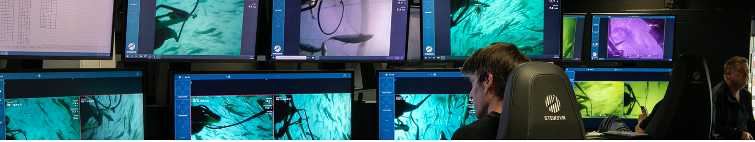
Client Experience - Tassal
ASX listed Tassal Group is Australia’s largest aquaculture business that has been operating in Tasmania for more than 30 years. Underpinned by its people’s passion and commitment, it is now Australia’s largest producer of Atlantic Salmon and regarded as a global leader and industry pioneer.
What is Tassal’s view on using leasing for its equipment requirements
What was the effect of IFRS16
Notes:
Refer to Kim’s email for notes and cues

Slide 15



Client Experience - Tassal
IFRS 16 - How was the transition: the good the bad and the ugly
If you had your time again, what would you do differently or what advice you provide others
Will the impact of COVID change your view on leasing/IFRS16 treatments
Notes:
Refer to Kim’s email for notes and cues

Slide 16

CLIENT INSIGHT - LOIS

Slide 17
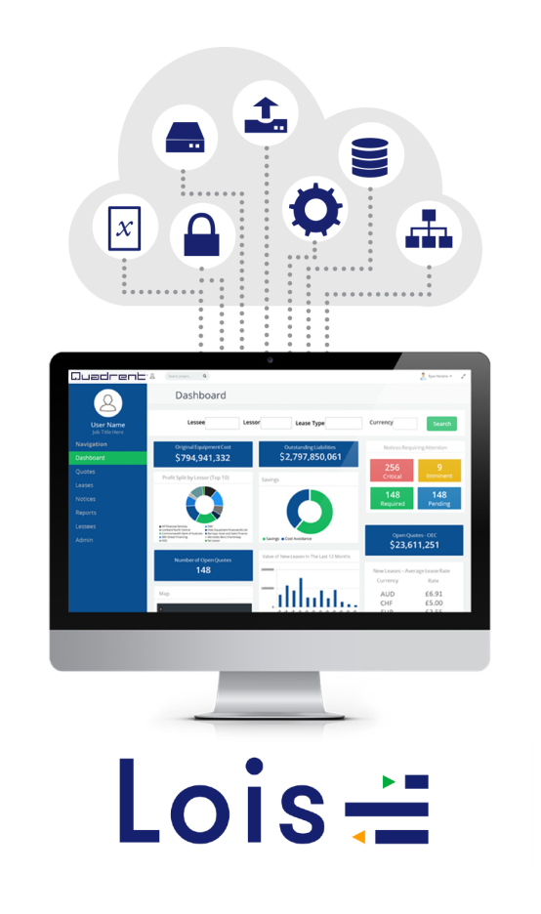




Client Experiences
Complexity
Approx 40% likely to replace spreadsheets
System ‘fit’
COVID-19 double down
Notes:
Are these the typical experiences you have seen Stefan in your LOIS travels?
See Stefan’s run sheet responses

Slide 18
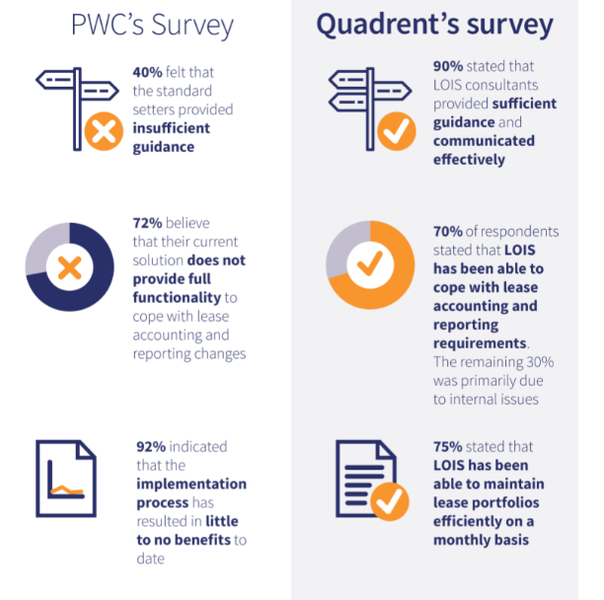
Our Client Experiences - Survey
How well has the IFRS 16 implementation gone?
A Comparison:
Notes:
Are these the typical experiences you have seen Stefan in your LOIS travels?

Slide 19







Client Experiences - War stories
Large retailer: 5-year lease on a truck entering 15th year, still paying full rental …… and truck was sold 5 years prior !!!
Waste Management Co: Failed to report quarterly earnings and needed to change systems quickly
Compliance with new standards
Drive Portfolio Savings
Enhance Processes
Improve Portfolio Efficiency
All 170+ Implementations
Pro-active Lease Management
Identify Data/System Gaps
ASX Top 50: 40 x 3 year leases with one lessor running for 7 years
Increased Portfolio Visibility
Large Retailer: Found 400 forklifts...

Slide 20

COVID -19: The Key Areas for IFRS 16 (EY)

Slide 21
IFRS 16 Focus Area – Lease Modifications
A change in the scope of a lease, or consideration, that was not part of the original T&Cs, for example:
    Adding or terminating the right to use asset(s)
    Extending or shortening the contractual lease term
    However: Exercising existing purchase or renewal options (or changing the assessment of likelihood of exercise) are not lease modifications (but require remeasurement)
Does the modification result in a separate lease?
    Increases scope by adding the right to use one or more underlying assets; AND
    Consideration increase is commensurate with standalone selling price
      Example: Increase in square footage leased, at market rate for additional space
    If so, account for a new lease separately (without adjusting existing lease)
    Otherwise, remeasure existing lease liability…

Slide 22

IFRS 16 Focus Area – Lease Modifications
For leases not accounted for as separate leases:
  Remeasure lease liability using discount rate at date of modification
  If the adjustment decreases the scope of the lease (e.g. reduces square footage of leased space):
    Decrease the ROU asset to reflect the proportional adjustment
    Any difference is a gain or loss (P/L)
  Otherwise, (e.g. increases in scope by extending contractual term):
    Adjust liability and ROU asset without affecting P/L
    Example: modification that is a change (reduction) in consideration only

Slide 23

COVID-19 related rent concessions: IFRS 16 amendments
Rent concessions expected to be provided to lessees
Complexity in applying these requirements to a large portfolio of leases (assessing changes, liability remeasurements etc)
IFRS 16 amendment:
    Optional practical expedient for lessees to not assess whether concessions represent a lease modification
    Instead, reflect “negative variable consideration” (usually a P/L credit)
Challenges:
    True forgiveness or a mere deferral of rent?
    Total lease consideration must be ‘substantially the same or less’
    Only affects payments due on or before 30 June 2021
    No other substantive changes
    Not available to lessors

Slide 24

Key Takeaways

Slide 25


Key Takeaways Today – the ‘New Normal’
The affects of COVID-19 has seen companies look to strengthen cash reserves and diversify funding lines
  Not to wait, but to move forward and future proof the business
  Keep traditional funding lines for a rainy day
Leasing – a great tool to have and one that is on the rise
Enables preservation of critical cash reserves
Diversifies funding without bank security
Competitive to Debt pricing
Avoids large upfront CapEX costs
Aligns payment for the use of the solution with income & efficiency gains over time
IFRS 16 – it is important to understand the changes it has brought about
Complex and has major implications – modifications!
Spreadsheets aren’t the way forward – LOIS
Technical advice can save you time and money and start you on the right path
The time is now to act and Quadrent and EY can assist

Slide 26

?
QUESTIONS

